Slide 1
Generating Images in the Style of a Chosen Artist
Ryan Richardson
CS-770 Deep Learning

Slide 2
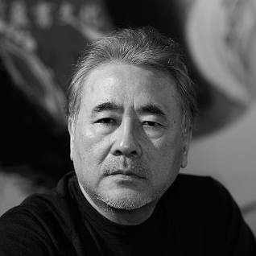
The Artist
Yoshitaka Amano
Japanese Artist
Has worked across all forms of media
Style
Primarily Water Colour + B&W
Loose Details to Extremely Detailed Imges
High-Fantasy and Techno Fantasy

Slide 3
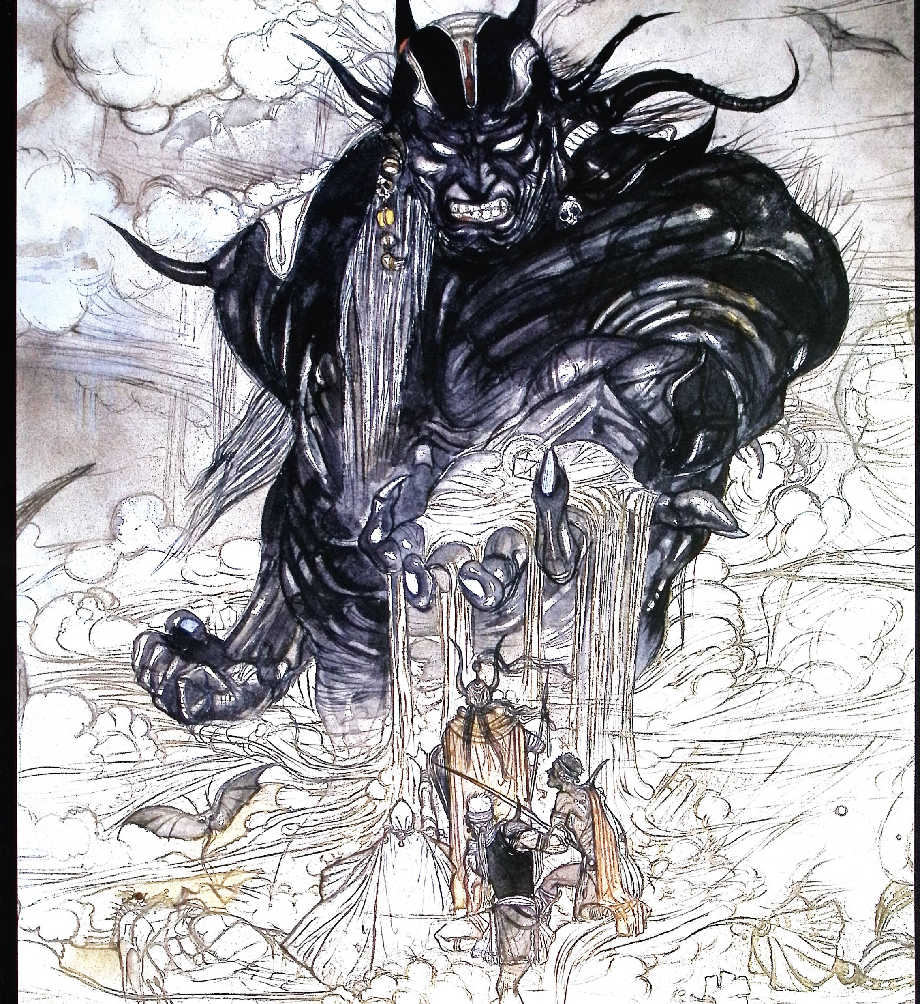
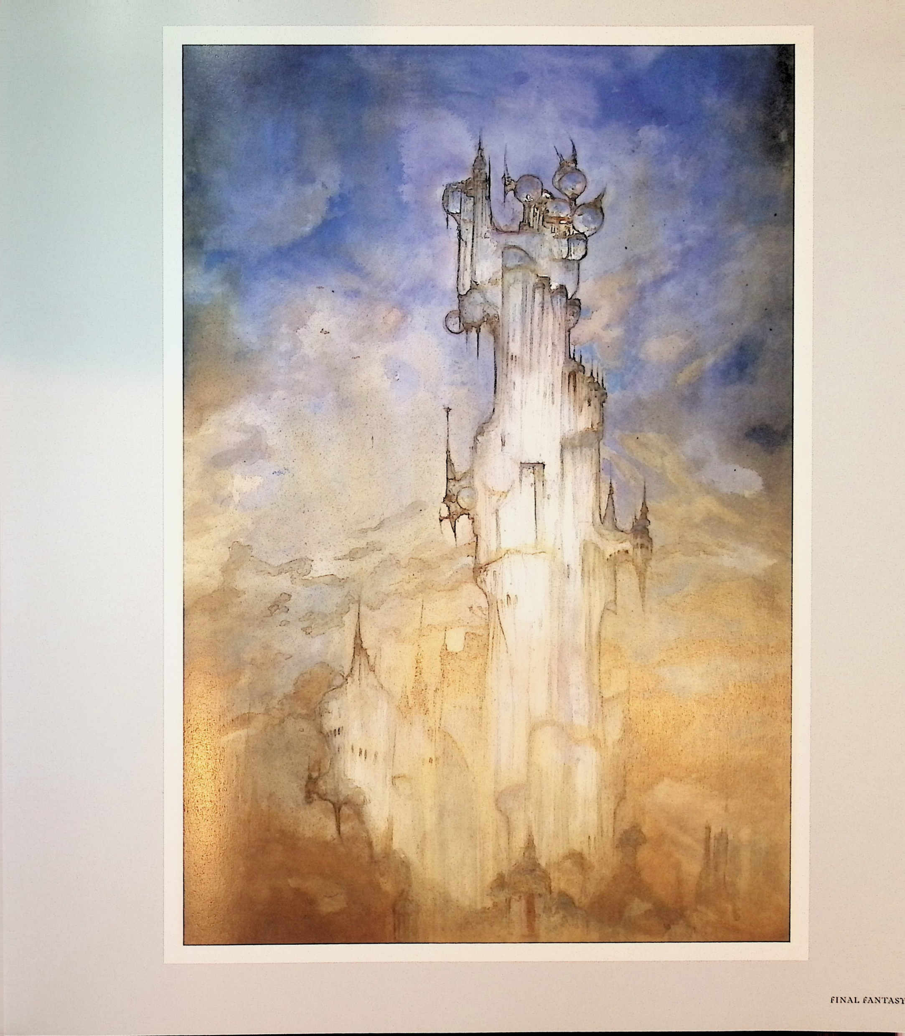
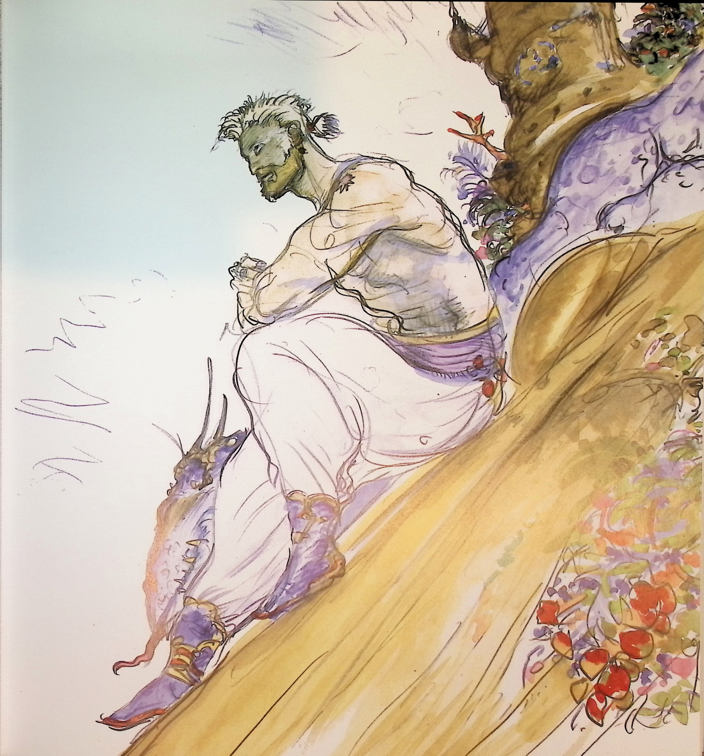
Gathering Training Data
Scanned ~ 1000 pages from Various Art Books
Scraped Archival & Fan Sites (Google, Tumblr, Imgur)

Slide 4
Challenges
Limited Training Data for a GAN
Varied Art Styles
Limited training data across different styles led to confused images
Physical Scan Quality
Glare, Colour Distortion, Multiple Drawings per Page
Few Archives Existed (No Complete Archive)
Some Sources were unusable because of drastic stylistic differences
Excessive Training Times

Slide 5
Implementation
Based on Nvidia’s StyleGAN2 Architecture specifically for ADA
Adaptive Discriminator Augmentation
Allows for smaller training sets to be converted into larger training sets
Using Pytorch Created a GAN + pseudo-ADA through image transformations

Slide 6
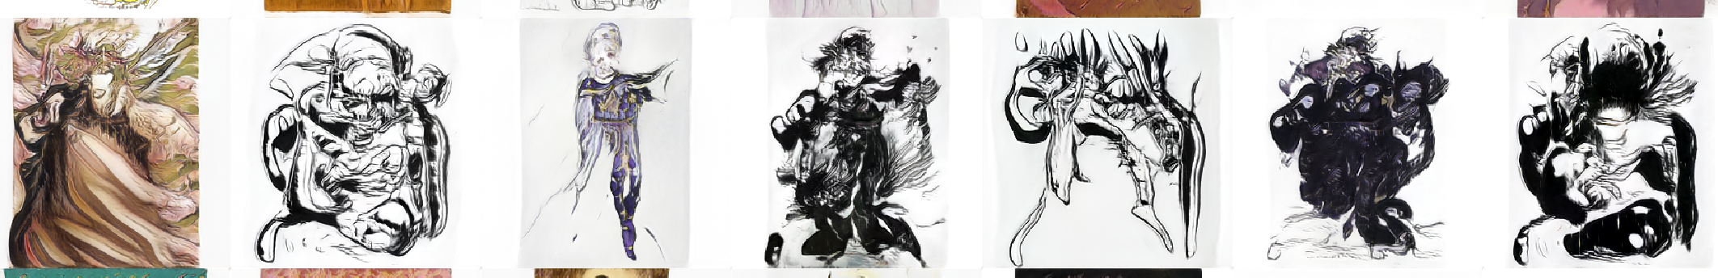
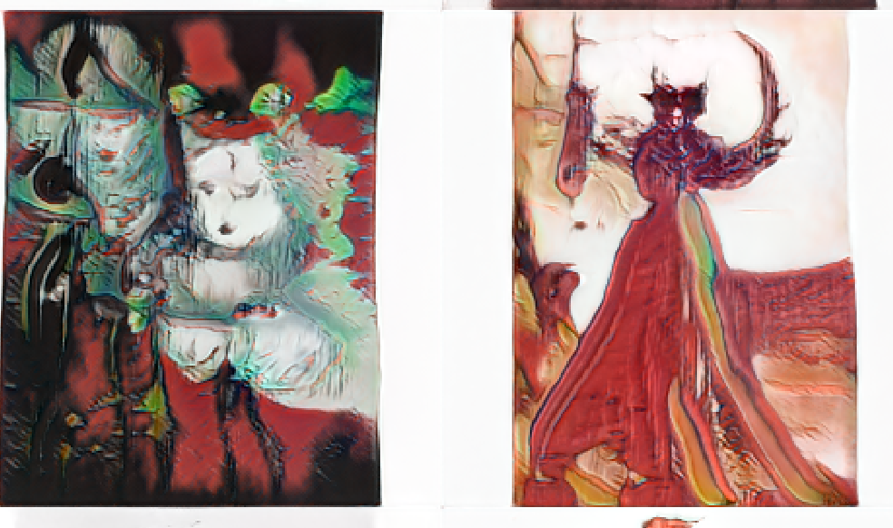
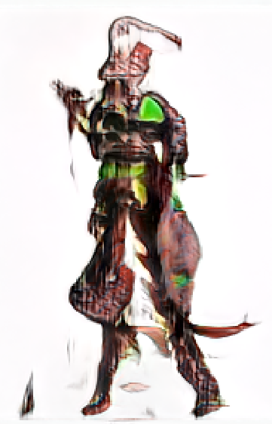
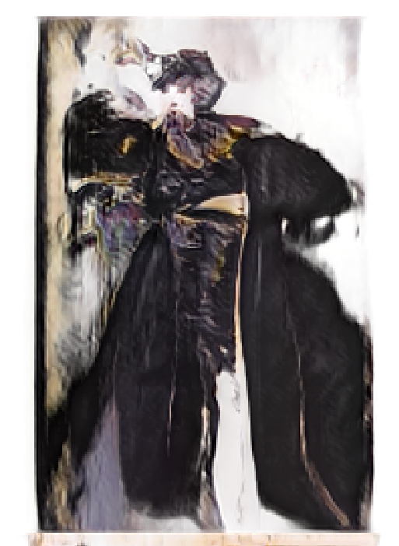
Best Results

Slide 7
Further Improvements
Increase Scan Quality
Separate Scanned Images to 1 Drawing per Image
Larger Networks w/ more convolutions
Limit ADA Transforms to most effective
Automated Hyperparameter Tuning
Cloud Compute Time

